Slide 1
Search and Sequential Action
CHAPTER 3
Oliver Schulte
Simon Fraser University
pay back money
CMPT 310 - Blind Search

Slide 2
Outline
Problem formulation: representing sequential problems.
Example problems.
Planning for solving sequential problems without uncertainty.
Basic search algorithms
CMPT 310 - Blind Search

Slide 3
Environment Type Discussed In this Lecture
Fully Observable
Static Environment
Atomic States
(not factored or structured)
yes
Deterministic
yes
Sequential
yes
no
Discrete
no
yes
Discrete
no
yes
Planning, heuristic search
Control, cybernetics
Constraint Satisfaction
Continuous Function Optimization
CMPT 310 - Blind Search
Notes:
CSP = Vector Search.

Slide 4
Search Problems
CMPT 310 - Blind Search

Slide 5
Choice in a Deterministic Known Environment
Without uncertainty, choice is trivial in principle: choose what you know to be the best option.
Trivial if the problem is represented in a look-up table.
Option | Value
Chocolate | 10
Wine | 20
Book | 15
CMPT 310 - Blind Search

Slide 6
Computational Choice Under Certainty
But choice can be computationally hard if the problem information is represented differently.
Options may be structured and the best option needs to be constructed.
  E.g., an option may consist of a path, sequence of actions, plan, or strategy.
The value of options may be given implicitly rather than explicitly.
  E.g., cost of paths need to be computed from map.
CMPT 310 - Blind Search

Slide 7

Sequential Action Example
Deterministic, fully observable → single-state problem
  Agent knows exactly which state it will be in; solution is a sequence
  Romania → The full map is observed
Single-state: Start in #5. Solution??
  [Right, Suck]
  Vacuum world → everything observed
CMPT 310 - Blind Search

Slide 8
Example: Romania
On holiday in Romania; currently in Arad.
Flight leaves tomorrow from Buchares
Formulate goal: be in Bucharest
    states: various cities
    actions: drive between cities
Find solution:
sequence of cities, e.g., Arad, Sibiu, Fagaras, Bucharest
Formulate problem:
CMPT 310 - Blind Search

Slide 9

Example: Romania
Abstraction: The process of removing details from a representation
Is the map a good representation of the problem? What is a good replacement?
CMPT 310 - Blind Search

Slide 10
General problem formulation
A problem is defined by four items:
initial state e.g., "at Arad“
actions or successor function S(x) = set of action–state pairs
  e.g., S(Arad) = {<Arad → Zerind, Zerind>, … }
goal test, can be
  explicit, e.g., x = "at Bucharest"
  implicit, e.g., Checkmate(x)
path cost (additive)
  e.g., sum of distances, number of actions executed, etc.
  c(x,a,y) is the step cost, assumed to be ≥ 0
A solution is
  A sequence of actions leading from the initial state to a goal state
  A sequence of actions is called a plan
CMPT 310 - Blind Search

Slide 11

Vacuum world state space graph
states?
actions?
goal test?
path cost?
CMPT 310 - Blind Search

Slide 12
Vacuum world state space graph
states? integer dirt and robot location
actions? Left, Right, Suck
goal test? no dirt at all locations
path cost? 1 per action
CMPT 310 - Blind Search

Slide 13

Example: The 8-puzzle
states?
actions?
goal test?
path cost?
CMPT 310 - Blind Search

Slide 14
Example: The 8-puzzle
  On-line Version
states? locations of tiles
actions? move blank left, right, up, down
goal test? = goal state (given)
path cost? 1 per move
CMPT 310 - Blind Search
Notes:
[Note: optimal solution of n-Puzzle family is NP-hard]

Slide 15

Example: robotic assembly
states?:
  real-valued coordinates of robot joint angles
  parts of the object to be assembled
actions?:
  continuous motions of robot joints
goal test?:
  complete assembly
path cost?:
  time to execute
CMPT 310 - Blind Search

Slide 16
Problem Solving Algorithms
CMPT 310 - Blind Search

Slide 17
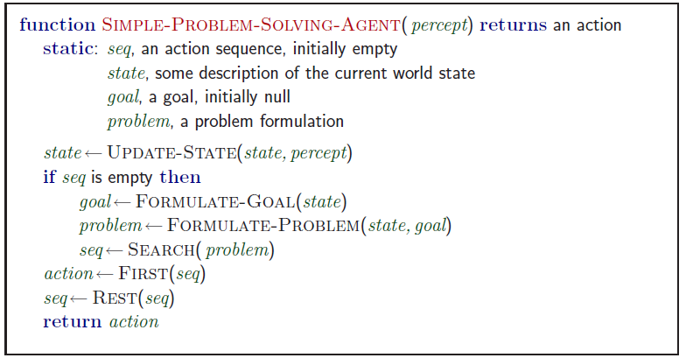
Problem-solving agents
Note: this is offline problem solving; solution executed “eyes closed.”
CMPT 310 - Blind Search

Slide 18

Tree search algorithms
Basic idea:
  offline, simulated exploration of state space by generating successors of already-explored states (a.k.a.~expanding states)
CMPT 310 - Blind Search

Slide 19

Tree search example
The space of sequences can be arranged as a tree
The search tree is a theoretical construct, not actually built
CMPT 310 - Blind Search

Slide 20

Tree search example
CMPT 310 - Blind Search

Slide 21

Tree search example
CMPT 310 - Blind Search

Slide 22
Search Graph vs. State Graph
Be careful to distinguish
  Search tree: Nodes are sequences of actions.
    The search tree never contains a cycle.
  State Graph: Nodes are states of the environment.
    The state graph may contain a cycle.
  Node in Search Tree = Path in State Graph
Demo: http://aispace.org/search/
CMPT 310 - Blind Search
Notes:
Under full observability, no big distinction between state of agent and state of the world.
Do Demo, while also drawing search tree.

Slide 23
Evaluating Search Strategies
A search strategy is defined by picking the order of path expansion
Strategies are evaluated along the following dimensions:
  completeness: does it always find a solution if one exists?
  time complexity: number of nodes generated
  space complexity: maximum number of nodes in memory
  optimality: does it always find a least-cost solution?
Time and space complexity are measured in terms of
  b: maximum branching factor of the search tree
  d: depth of the least-cost solution
  m: maximum depth of the state space (may be ∞)
CMPT 310 - Blind Search
Notes:
Very popular, basically graph theory

Slide 24
Search Strategies
Breadth-First
Depth-First
Iterated Depth-First
CMPT 310 - Blind Search

Slide 25
Uninformed search strategies
Uninformed search strategies
  use only the information available in the problem definition
  No domain knowledge or expertise
Breadth-first search
Depth-first search
Depth-limited search
Iterative deepening search
CMPT 310 - Blind Search

Slide 26

Breadth-first search
Expand shortest paths
Frontier = set of but generated paths
Frontier = leaf nodes in the search tree.
Implementation:
  Frontier is a FIFO queue, i.e., new successors go at end
CMPT 310 - Blind Search

Slide 27

Breadth-first search
Expand shortest paths
Implementation:
  frontier is a FIFO queue, i.e., new successors go at end
CMPT 310 - Blind Search

Slide 28

Breadth-first search
Expand shortest paths
Implementation:
  frontier is a FIFO queue, i.e., new successors go at end
CMPT 310 - Blind Search

Slide 29

Breadth-first search
Expand shortest pathshttp://aispace.org/search/
Implementation:
  frontier is a FIFO queue, i.e., new successors go at end
CMPT 310 - Blind Search

Slide 30
Properties of breadth-first search
Complete? Time? Space?Optimal?
Complete? Yes (if b is finite)
Time? 1+b+b²+b³+… +b^{d} = O(b^{d})
Space? O(b^{d}) (keeps every node in memory)
Optimal? Yes
CMPT 310 - Blind Search
Notes:
We skip for now, come back later.
(if cost = 1 per step)?

Slide 31
Example Numbers
Assumptions
Branching Factor b | Node Generation/sec | Node size
10 | 1M | 1MB
Resource Consumption
Depth | Nodes | Time | Memory
10 | 10¹⁰ | 3 hours | 10 TeraBytes
12 | 10¹² | 13 days | 1 petabyte
Space is the big problem (more than time)
CMPT 310 - Blind Search

Slide 32

Depth-first search
Expand longest paths
Implementation:
  frontier = LIFO queue, i.e., put successors at front
CMPT 310 - Blind Search

Slide 33

Depth-first search
Expand longest path
Implementation:
  frontier = LIFO queue, i.e., put successors at front
CMPT 310 - Blind Search

Slide 34

Depth-first search
Expand longest path
Implementation:
  frontier = LIFO queue, i.e., put successors at front
CMPT 310 - Blind Search

Slide 35

Depth-first search
Expand longest path
Implementation:
  frontier = LIFO queue, i.e., put successors at front
CMPT 310 - Blind Search

Slide 36

Depth-first search
Expand longest path
Implementation:
  frontier = LIFO queue, i.e., put successors at front
CMPT 310 - Blind Search

Slide 37

Depth-first search
Expand longest path
Implementation:
  frontier = LIFO queue, i.e., put successors at front
CMPT 310 - Blind Search

Slide 38

Depth-first search
Expand longest path
Implementation:
  frontier = LIFO queue, i.e., put successors at front
CMPT 310 - Blind Search

Slide 39

Depth-first search
Expand longest path
Implementation:
  frontier = LIFO queue, i.e., put successors at front
CMPT 310 - Blind Search

Slide 40

Depth-first search
Expand longest path
Implementation:
  frontier = LIFO queue, i.e., put successors at front
CMPT 310 - Blind Search
Notes:
Beautifil connection to queue concepts

Slide 41

Depth-first search
Expand longest path
Implementation:
  frontier = LIFO queue, i.e., put successors at front
CMPT 310 - Blind Search

Slide 42

Depth-first search
Expand longest path
Implementation:
  frontier = LIFO queue, i.e., put successors at front
CMPT 310 - Blind Search

Slide 43

Depth-first search
Expand longest pathhttp://aispace.org/search/
Implementation:
  frontier = LIFO queue, i.e., put successors at front
CMPT 310 - Blind Search

Slide 44
Properties of depth-first search
Complete? Time? Space?Optimal?
Complete? No: fails in infinite-depth spaces, spaces with loops
  Modify to avoid repeated states along path (graph search)
Time? O(b^{m}): terrible if maximum depth m is much larger than solution depth d
  but if solutions are dense, may be much faster than breadth-first
Space? O(bm), i.e., linear space! Store single path with unexpanded siblings.
  Seems to be common in animals and humans.
Optimal? No.
Important for exploration (on-line search).
  → complete in finite spaces
CMPT 310 - Blind Search
Notes:
Not optimal because may fail to explore optimal subtree.

Slide 45
Depth-limited search
depth-first search with depth limit l,
  i.e., paths at depth l have no successors
  Solves infinite loop problem
Common AI strategy: let user choose search/resource bound.
Time? O(b^{l}) = complete tree up to depth l.
Space? O(bl), i.e., linear space!
Optimal? No if l > d (solution needs more than limit)
Complete? No if l < d:
CS 3243 - Blind Search
14 Jan 2004

Slide 46

Iterative deepening search
CMPT 310 - Blind Search

Slide 47

Iterative deepening search l =0
CMPT 310 - Blind Search

Slide 48

Iterative deepening search l =1
CMPT 310 - Blind Search

Slide 49

Iterative deepening search l =2
CMPT 310 - Blind Search

Slide 50

Iterative deepening search l =3
CMPT 310 - Blind Search
Notes:
http://www.ai.sri.com/~oreilly/aima3ejava/aima3ejavademos.html
Is seriously buggy

Slide 51
Iterative deepening search
Number of paths generated in a depth-limited search to depth d with branching factor b:
N_{DLS} = b⁰ + b¹ + b² + … + b^{d-2} + b^{d-1} + b^{d}
Number of paths generated in an iterative deepening search to depth d with branching factor b:
N_{IDS} = (d+1)b⁰ + d b¹ + (d-1)b² + … + 3b^{d-2} +2b^{d-1} + 1b^{d}
For b = 10, d = 5,
  N_{DLS} = 1 + 10 + 100 + 1,000 + 10,000 + 100,000 = 111,111
Overhead = (123,456 - 111,111)/111,111 = 11%
  NIDS = 6 + 50 + 400 + 3,000 + 20,000 + 100,000 = 123,456
CMPT 310 - Blind Search
Notes:
N_{DLS} = number of nodes at each level.
N_IDS = nodes at each level, generated multiple times for each depth d.
To see the time analysis, consider how often each node is visited given its level = how many times the level is revisited.

Slide 52
Properties of iterative deepening search
Complete? Yes
Time? (d+1)b⁰ + d b¹ + (d-1)b² + … + b^{d} = O(b^{d})
Space? O(bd)
Optimal? Yes, if step cost = 1
CMPT 310 - Blind Search
Notes:
Marries the advantages of breadth-first search with depth-first search.
To see the time analysis, consider how often each node is visited given its level = how many times the level is revisited.

Slide 53
Summary of algorithms
Criterion | Breadth-First | Depth-First | Depth-Limited | Iterative Deepening
Complete? | Yes | No | No | Yes
Time | O(b^{d}) | O(b^{m}) | O(b^{l}) | O(b^{d})
Space | O(b^{d}) | O(bm) | O(bl) | O(bd)
Optimal? | Yes | No | No | Yes
CMPT 310 - Blind Search

Slide 54
Graph Search
CMPT 310 - Blind Search
Notes:
Vs. tree search.

Slide 55

Repeated states
Failure to detect repeated states can turn a linear problem into an exponential one!
CMPT 310 - Blind Search

Slide 56

Graph search
Simple solution: just keep track of which states you have visited.
Usually easy to implement in modern computers.
CMPT 310 - Blind Search

Slide 57
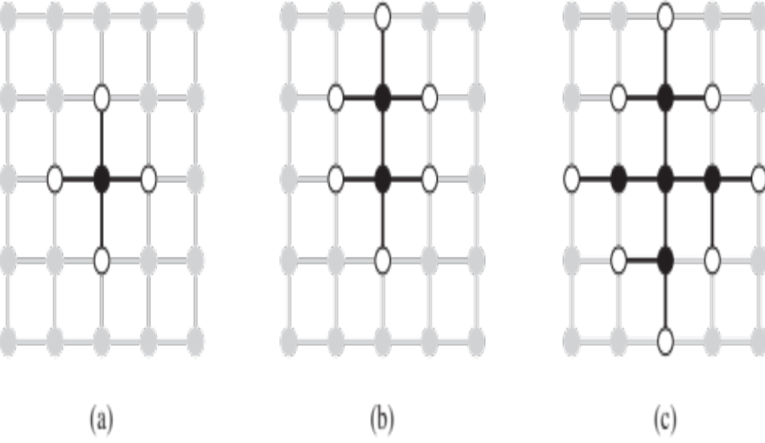
The Separation Property of Graph Search
Black: expanded nodes.
White: frontier nodes.
Grey: unexplored nodes.
CMPT 310 - Blind Search

Slide 58
Summary
Problem formulation usually requires abstracting away real-world details to define a state space that can feasibly be explored
Variety of uninformed search strategies
Iterative deepening search uses only linear space and not much more time than other uninformed algorithms
CMPT 310 - Blind Search

